Slide 1
DATA SCIENCE PROJECT
Premier League Fans
GitHub

Slide 2
About The Premier League
Founded 20 February 1992; 29 years ago
The team with the Most championships is Manchester United (13 titles)
The player with the Most appearances is Gareth Barry (653)
The player in the Top goal scorer is Alan Shearer (260)
The Premier League is the most-watched sports league in the world, broadcast in 212 territories to 643 million homes and a potential TV audience of 4.7 billion people.
The Premier league with aggregated attendance across all matches is the highest of any league at 14,508,981 fans

Slide 3
Top 5 Team Fans
Manchester United
Arsenal
Liverpool
Tottenham
West Ham

Slide 4
RESEARCH QUESTION
How many variables affect the amount of fans who come to the games?

Slide 5
TABLE OF CONTENTS
1
2
3
4
DATA ACQUISITION
DATA CLEANING
Using crawling
Cleaning information
and filtering data
EDA
MACHINE LEARNING
Visualization of
the data
Modeling and predicting

Slide 6
1
DATA ACQUISTION
CRAWLING

Slide 7
LINKS
GENERAL INFORMATION: https://en.wikipedia.org/wiki/Premier_League
Crawling
https://fbref.com/en/comps/9/Premier-League-Stats

Slide 8
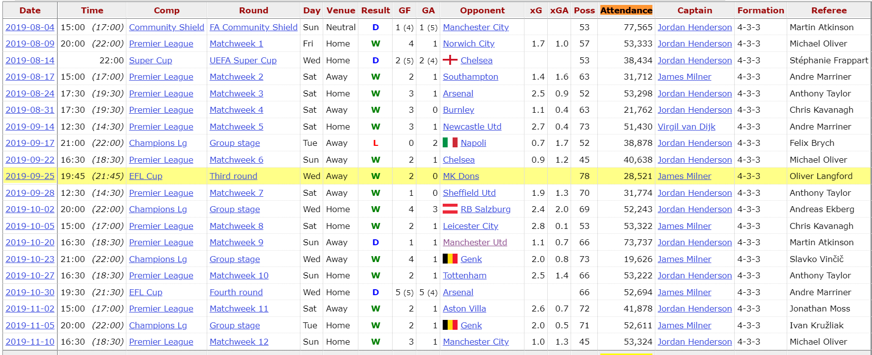
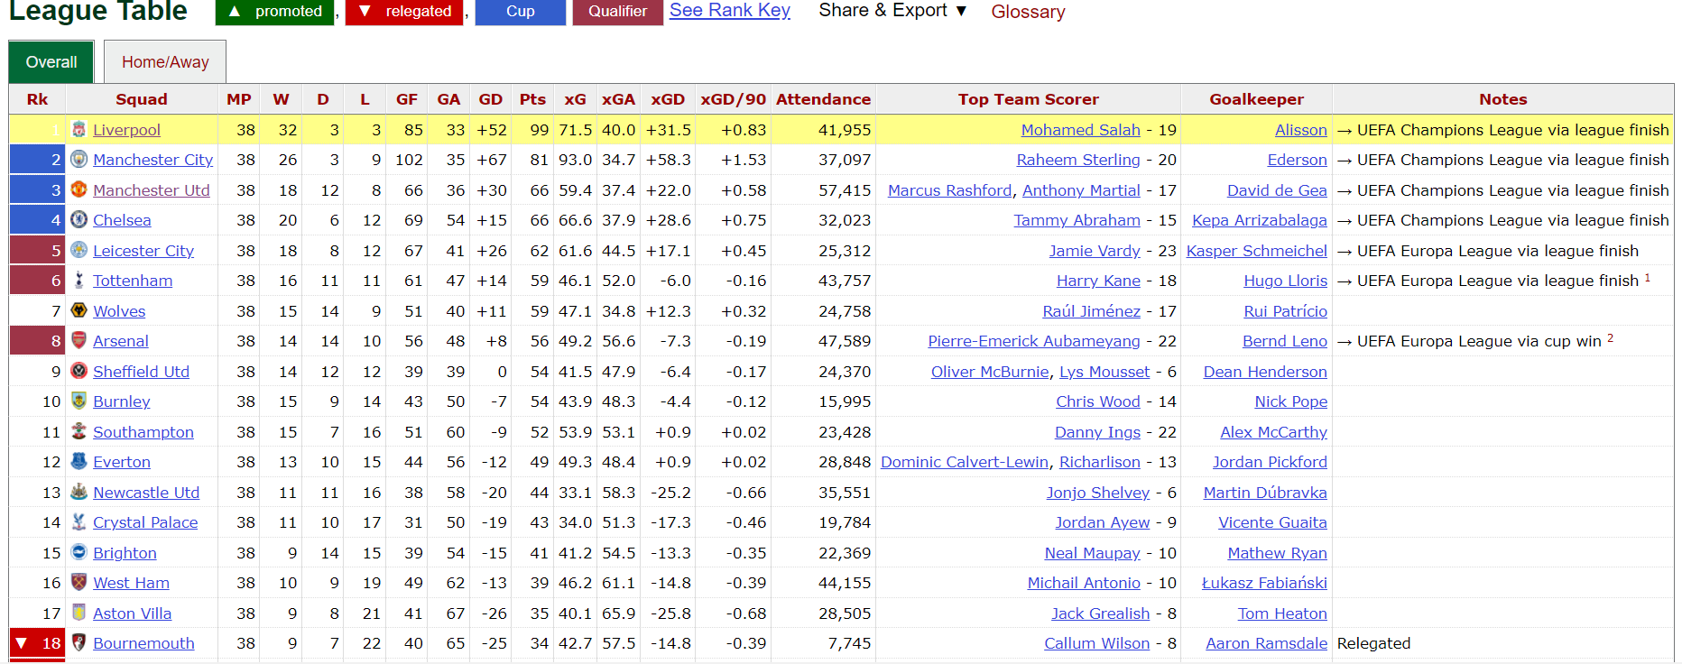
DATA ACQUISITION - CRAWLING -
We used BeautifulSoup library to scrape the relevant information (Name team , Veneu, Time , Result) from FBREEF website.

Slide 9
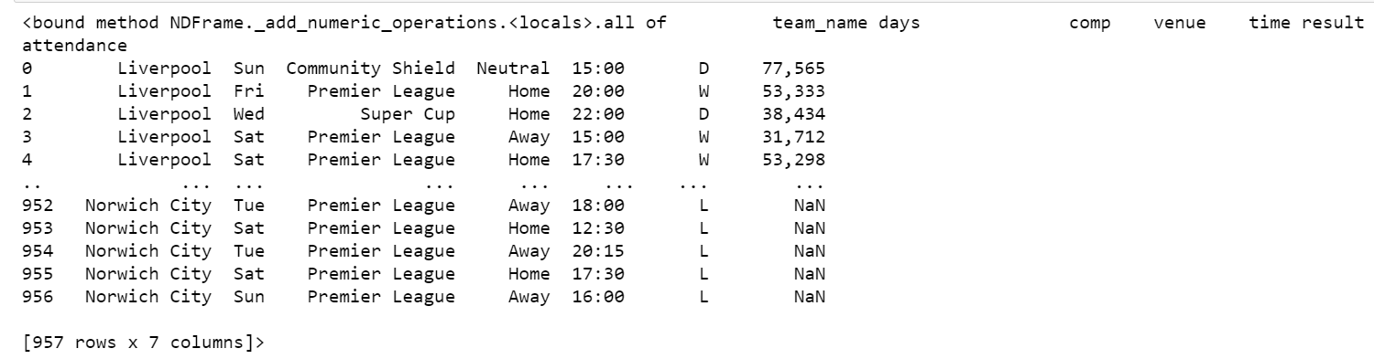
THE DATA FRAME
The all data

Slide 10

02 DATA CLEANING
Cleaning information and filtering data

Slide 11
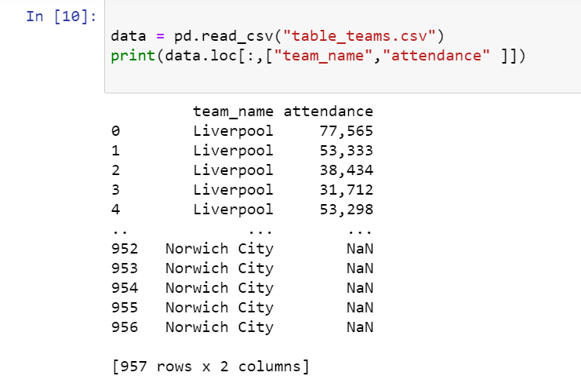
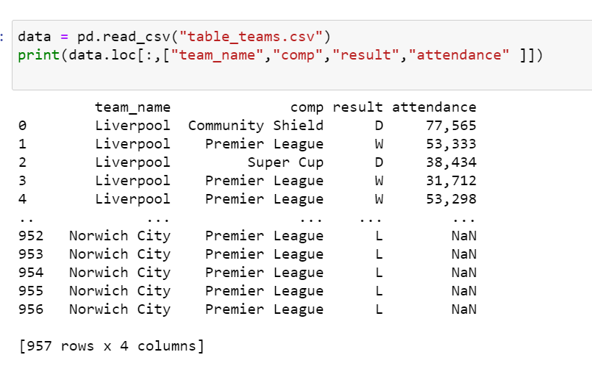
DATA CLEANING
I removed entries to make comparisons and tests

Slide 12
03 EDA Visualization of the data

Slide 13
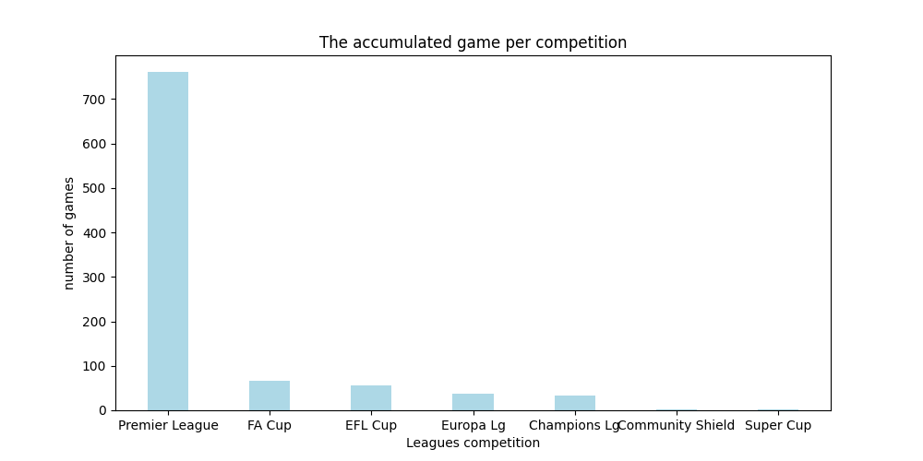
EDA
The competition with the most games of the season

Slide 14
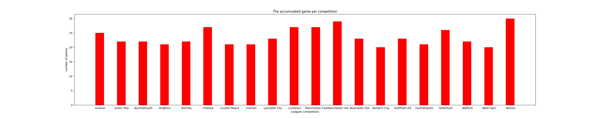
Each team and the amount of games it played
MARS

Slide 15
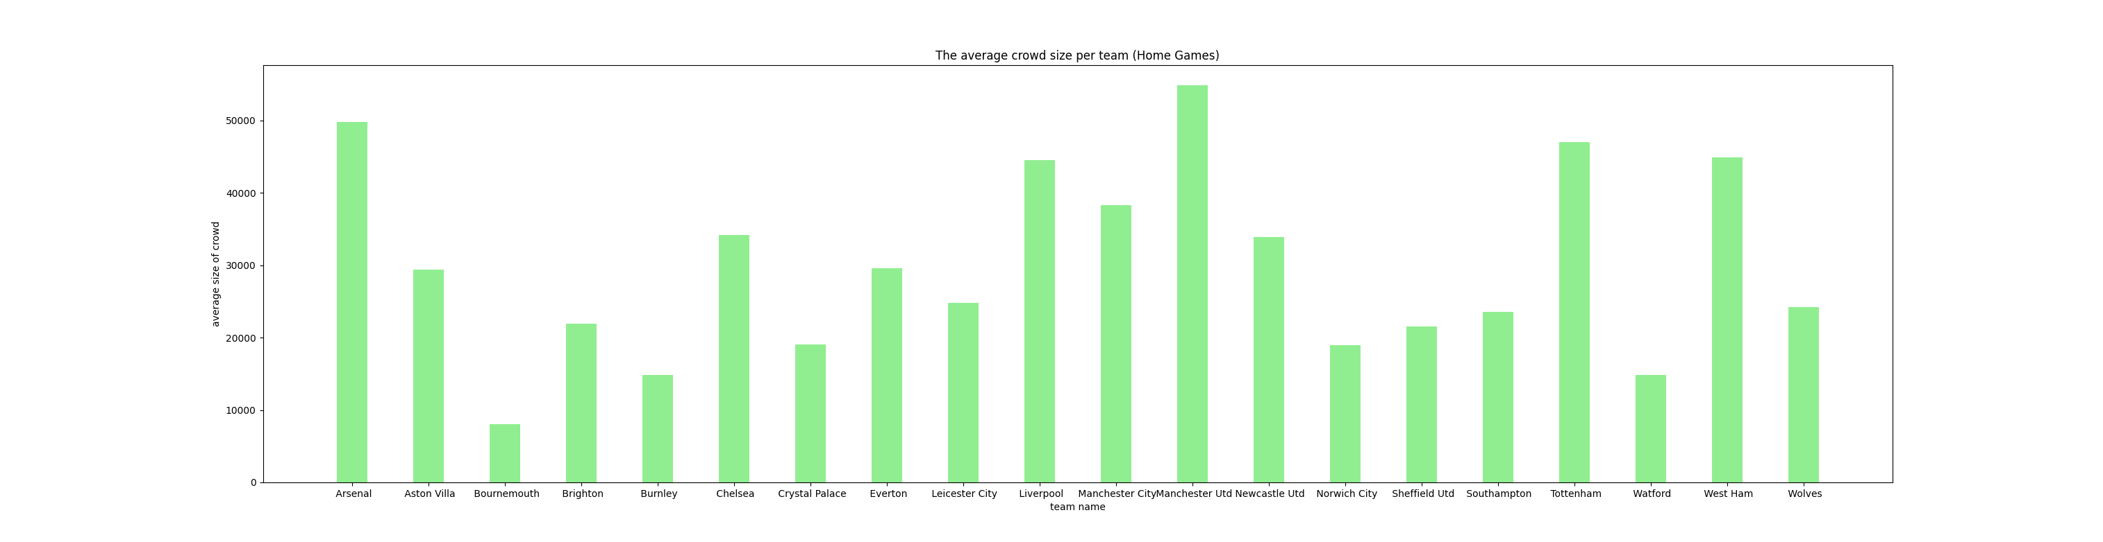
The average audience of each group

Slide 16
04 MACHINE LEARNING
Modeling and predicting

Slide 17
MACHINE LEARNING
The most played competition is the league competition
REMOVED STRING ROWS-Delete rows of away games
The most worn competition is the league competition
AVERAGE Attendance-Average calculation of home games

Slide 18
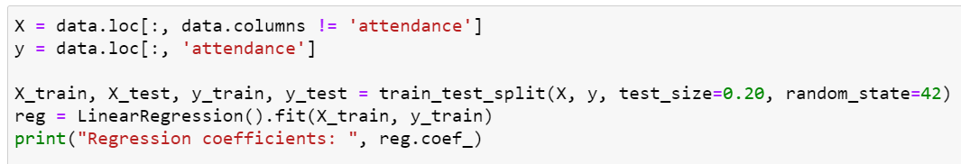
MACHINE LEARNING
LOGISTIC REGRESSION
I am wanted to predict the success rate so we separate the column from the dataset

Slide 19
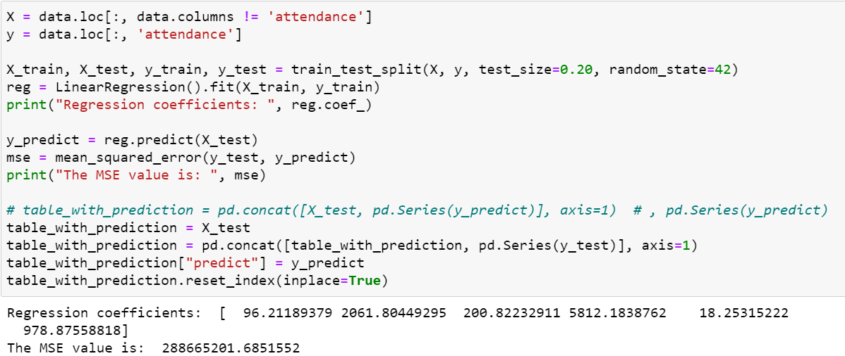
MACHINE LEARNING
LOGISTIC REGRESSION
I am created a logistic regression model in order to predict the Attendance of any game

Slide 20

MACHINE LEARNING
LOGISTIC REGRESSION
In order to calculate the average without hurting the games that were without an audience, I downloaded all the lines that had 0 fans

Slide 21
CONCLUSIONS
The team with the highest average is Manchester United
The team that won the championship is actually Liverpool and is the third in the average crowd
The team with the lowest average is Bournemouth and it has been relegated
We can see that success has a direct bearing on the average audience but also the history of the team in recent years has an impact

